Slide 1
Exploratory Data Analysis

Slide 2
Dataset
Census 2011 of Indian Cities with Population more than 1 Lac.
Variables include :-
Name_of_city
State code
Population
Literates
Number of Graduates

Slide 3
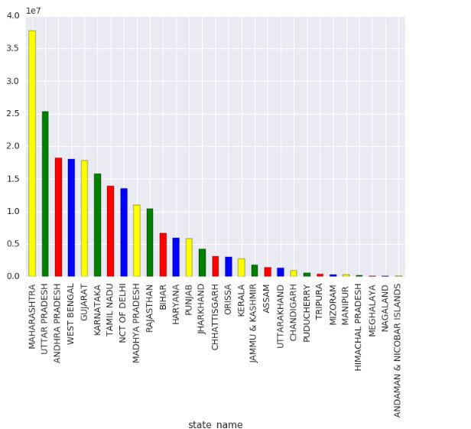
STATE VS POPULATION PLOT

Slide 4
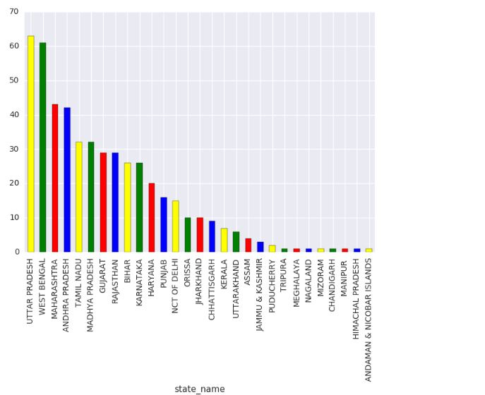
State vs Number of Cities plot

Slide 5
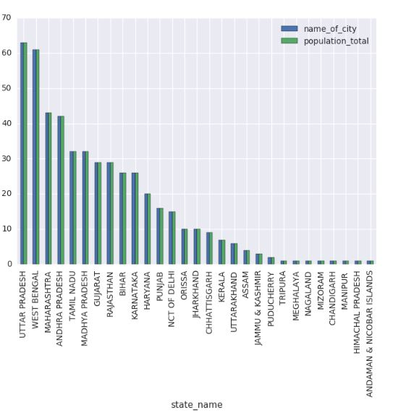
State vs City and Population

Slide 6
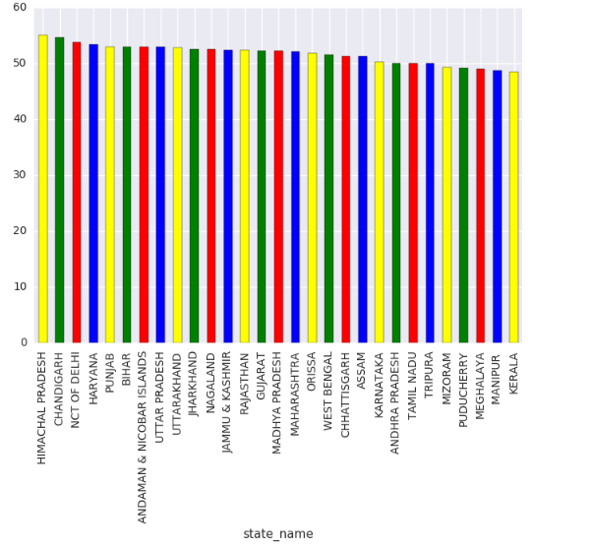
State By Male Percentage

Slide 7
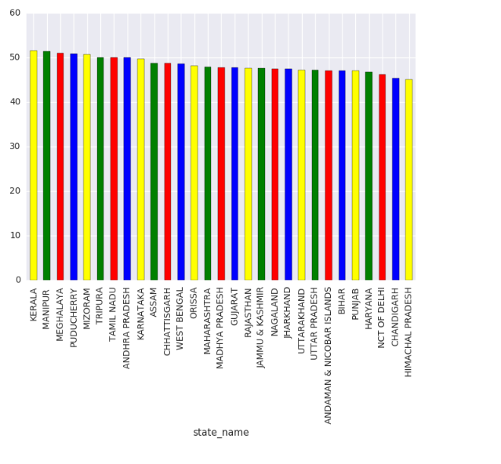
State By Female Percentage

Slide 8
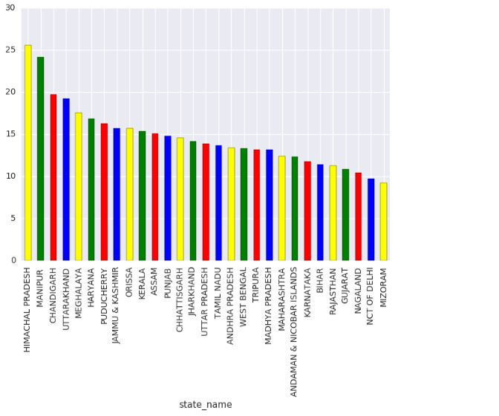
States by total graduates in Population

Slide 9
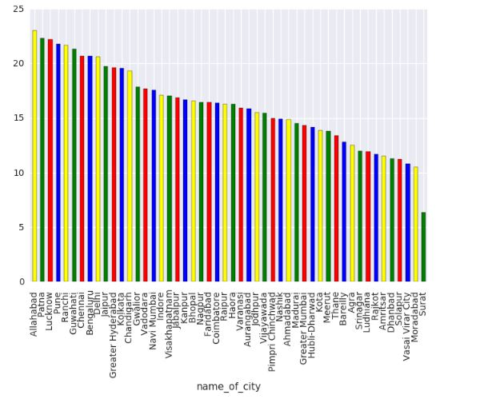
States by Male Graduation percentage in Male population

Slide 10
Thank You!!!

